Slide 1
Network Programming: Inter-Process Communications
Shyan-Ming Yuan
CS Department, NYCU
smyuan@gmail.com

Slide 2
Cooperating Processes
Processes within a system may be independent or cooperating
Independent process cannot affect or be affected by the execution of another process
Cooperating processes can affect or be affected by the execution of other cooperating processes
In general, processes or threads must exchange data with each other to cooperate usefully
Cooperating processes need inter-process communication (IPC) facilities
There are two kinds of IPC models
Shared memory
Message passing

Slide 3
IPC Models

Slide 4
Purposes for IPC
Data Transfer
Sharing Data
Event notification
Resource Sharing and Synchronization
Process Control

Slide 5
IPC – Shared Memory
For processes
Each process has own private address space
Shared memory segment must be explicitly set up within each address space
For threads of the same process
There exists shared address space (use heap for shared data)
Advantages
Fast and easy to share data
Disadvantages
Must synchronize data accesses to avoid race condition

Slide 6
IPC – Message Passing
Message passing is commonly used between processes
Explicitly passing data between sender (src) and receiver (destination)
Example: pipes, sockets
Advantages:
Makes sharing explicit (readability)
Improves modularity (narrow interface)
Disadvantages:
Performance overhead to copy messages
Issues:
How to name source and destination?
One process, set of processes, or mailbox (port)
Does the sending process wait (I.e., block) for the receiver?
Blocking: Slows down the sender
Non-blocking: Requires buffering between the sender and the receiver

Slide 7
Unicast vs. Multicast

Slide 8
Message Passing in basic HTTP
Operations in server:
S1: accept connection
S2: receive request
S3: send response
S4: disconnect
Operations in browser:
C1: make connection
C2: send request
C3: receive response
C4: disconnect
Processing order: C1, S1, C2, S2, S3, C3, C4, S4

Slide 9
Naming in Message Passing
Direct channel:
The unique process identifiers are used for source and destination
It might be impossible to specify the source ahead of time (e.g., a print server)
Indirect channel (more convenient):
Messages are sent to a shared mailbox which consists of a queue of messages
Senders place messages in the mailbox, receivers pick them up

Slide 10
Direct Channel
Processes must name each other explicitly
Symmetric Addressing
send (P, message) – send to process P
receive (Q, message) – receive from Q
Asymmetric Addressing
send (P, message) – send to process P
receive (&id, message) – receive from any; system sets id to sender
Properties:
Links are established automatically between pairs
Processes must know each others in advance
Exactly one link per pair of communicating processes
Disadvantage: a process must know the name or ID of the processes it wishes to communicate with

Slide 11
Indirect Channel
Messages are sent to or received from mailboxes (or ports)
Each mailbox has a unique id
Processes can communicate only if they share a mailbox
Properties:
Links are established only if processes share a common mailbox
A link may be associated with more than 2 processes
Each pair of processes may share several communication links
Operations
create a new mailbox
send and receive messages through mailbox
send (A, message) – send a message to mailbox A
receive (A, message) – receive a message from mailbox A
destroy a mailbox

Slide 12
Message Passing IPCs
Pipe
FIFO (named pipe)
Socket

Slide 13
Pipes
A pipe is a unidirectional communication channel.
Data written to the “write end” of the pipe can be read back from the “read end.”
Pipes are FIFO devices, data is always read from the pipe in the same order it was written.
Typically, a pipe is used to communicate between two threads in a single process or between parent and child processes.
A pipe’s data capacity is limited
If a pipe is full, the writer process blocks until more capacity becomes available.
If the reader tries to read from an empty pipe, it blocks until data becomes available.
The pipe automatically synchronizes the two related processes.

Slide 14
Creating pipes in Linux
To create a pipe, one can use the pipe system call.
It returns an integer array (file descriptors) of size 2.
The call to pipe stores the reading file descriptor in position 0 and the writing file descriptor in position 1.
For example, consider the following codes:
Data written to the file descriptor write_fd can be read back from read_fd.
int pipe_fds[2];
int read_fd;
int write_fd;
pipe (pipe_fds);
read_fd = pipe_fds[0];
write_fd = pipe_fds[1];

Slide 15
An Example of Pipe
#include <unistd.h>
#include <fcntl.h>
#include <stdio.h>
char *message = "This is a message!!!" ;
main()
{ char buf[1024] ;
int fd[2];
pipe(fd); /*create a pipe*/
if (fork() != 0) { /* I am the parent */
close(fd[0]); /* closed the un-used read-end */
write(fd[1], message, strlen (message) + 1) ;
}
else { /*Child code */
close(fd[1]); /* closed the un-used write-end */
read(fd[0], buf, 1024) ;
printf("Got this from Parent process!!: %s\n", buf) ;
}
}

Slide 16
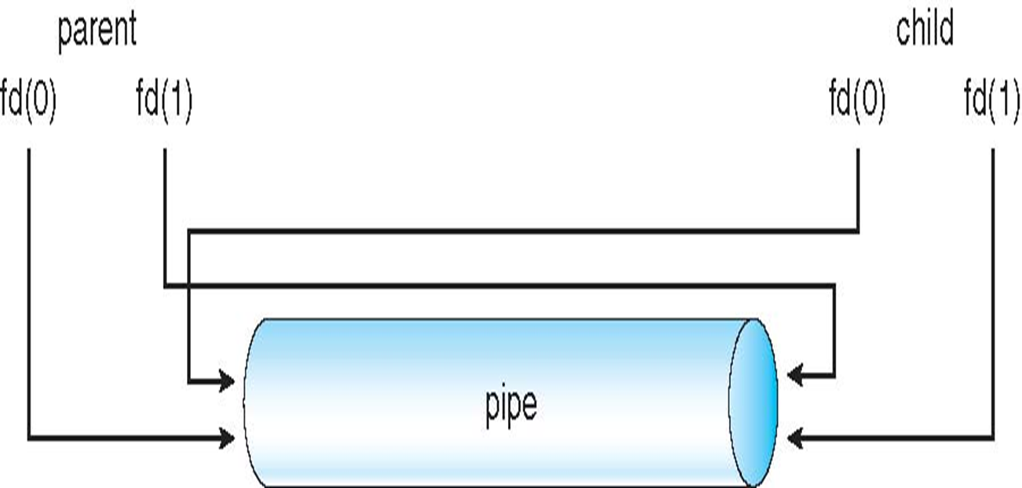
The pipe

Slide 17
FIFOs
A first-in, first-out (FIFO) file is a pipe that has a name in the file system.
Any authorized process can open or close the FIFO.
The processes on either end of the FIFP need not be related to each other.
FIFOs are also called named pipes.

Slide 18
Creating FIFOs in Lunix
The mkfifo command can be used to create a FIFO.
Specify the path to the FIFO on the command line.
For example, create a FIFO in /tmp/fifo by invoking this:
% mkfifo /tmp/fifo
Since this named pipe looks like a file, one can use all the system calls associated with files to interact with it.
In particular, one can use the open, read, write, and close system calls.
The following are prototypes for each of these system calls
int open(const char *pathname, int flags);
int read(int fd, void *buf, size_t count);
int write(int fd, const void *buf, size_t count);
int close(fd);
Reading and writing to named pipes are blocking in nature.
For example, if a process writes to a named pipe, it will get blocked until there is process willing to read that pipe and vice versa.

Slide 19
Working with FIFO in a Shell
Creating a FIFO by the following two commands.
mkfifo fifo1
mknod fifo1 p
Reading/Writing data from/to a FIFO.
open two terminals
In the first terminal, types “cat > fifo1”
In the second terminal, types “cat fifo1”
Writes to the 1st terminal
One will notice that every time an enter is typed, the corresponding line appears in the second terminal.
Pressing CTRL+D in the first terminal terminates writing to fifo1
This also terminates the second process because reading from the fifo1 now generates a “BROKEN PIPE” signal.
The default action for this is to terminate the process.

Slide 20
Sockets
A socket is a bidirectional communication channel.
It can be used to communicate with another process on the same machine or on the different machine.
Internet programs such as Telnet, rlogin, FTP, talk, and the World Wide Web use sockets.
A socket is defined as an endpoint for communication.
Named by concatenation of IP address and port number.
The socket 161.25.19.8:1625 refers to
port 1625 on host 161.25.19.8.
Communication consists of a pair of sockets.

Slide 21
Socket Concepts
To create a socket, three parameters are required:
communication style, namespace, and protocol
A communication style controls how the socket treats transmitted data and specifies the number of communication partners.
When data is sent through a socket, it is packaged into chunks called packets
The communication style determines how these packets are handled and how they are addressed from the sender to the receiver.
Connection styles guarantee in order delivery of all packets
It is like a telephone call.
The addresses of the sender and receiver are fixed at the beginning of the communication when the connection is established.
Datagram styles do not guarantee delivery or arrival order.
Packets may be lost or reordered in transit due to network errors or other conditions.
The system guarantees only “best effort,” so packets may disappear or arrive in a different order than shipping.
It behaves more like a postal mail.
The sender specifies the receiver’s address for each individual message.

Slide 22
Socket Namespaces
A socket namespace specifies how socket addresses are written.
A socket address identifies one end of a socket connection.
In the “local namespace,” a socket address is an ordinary filenames.
In “Internet namespace,” a socket address is composed of the Internet address (also known as an Internet Protocol address or IP address) of a host and a port number.
The port number distinguishes among multiple sockets on the same host.

Slide 23
Socket Protocols
A protocol specifies how data is transmitted.
There are some commonly used protocols.
TCP/IP, the primary networking protocols used by the Internet.
The AppleTalk network protocol
The UNIX local communication protocol
Not all combinations of styles, namespaces, and protocols are supported.

Slide 24
The Socket System Calls
Socket API

